Slide 1

BS1220: Introduction to Software Design and Development
Week 2: Hybrid Session 2

Slide 2

Hybrid Session 2
List Operations
String Operations
Input Command
None Keyword
Summary

Slide 3


2.7 (cont.): List Operations Crib Sheet
In your groups discuss your crib sheets – were there any that surprised you?

Slide 4



Strings can be seen as a list of characters
Use your crib sheet to assess which operations can also be carried out on strings.
Make sure you define a string which is at least 9 letters long (what the string is doesn’t matter – but keep it clean!)
Note: there may be some which do not work, so don’t panic if you get errors

Slide 5

2.8: Demo
The input() command

Slide 6

Activity 1
Adapt your program so that it also asks the user what their favourite subject at school / university is. Their input should be printed to the screen afterwards.

Slide 7
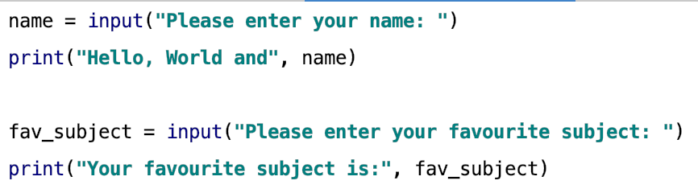
Solution

Slide 8

Demo
Addition Calculator

Slide 9

Activity
You will notice that the calculator isn’t producing the answer we would expect. How can we overcome this? Do some research to see what the problem is and how you can resolve it.

Slide 10
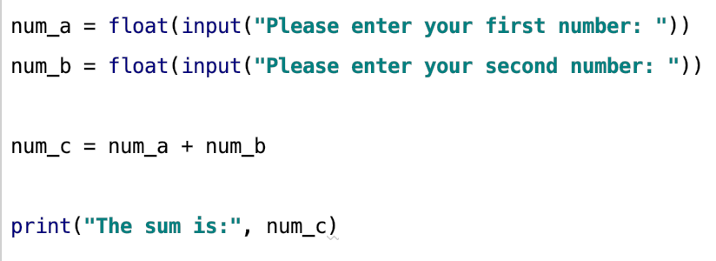
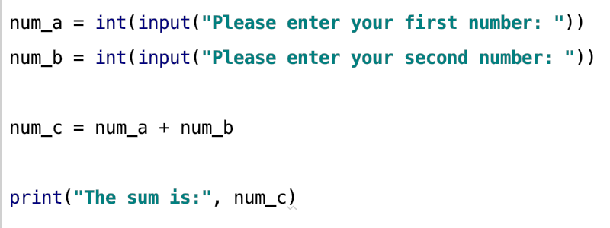
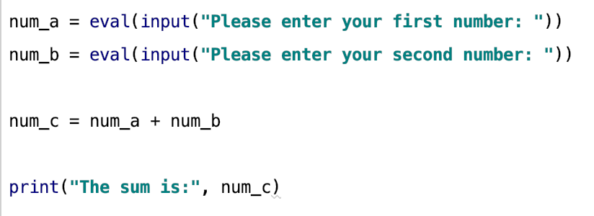
Solutions

Slide 11
2.9: None Keyword
Allows a null value (or no value) to be assigned to a variable
Has a data type of its own: NoneType
a_variable = None

Slide 12
2.10: Summary
To analyse the differences between strongly and weakly typed programming languages
To utilise the type() function within Python
To create and use variables within Python
To discuss code quality with a particular focus on PEP
To understand, create, and use lists within Python
To utilise basic string operations within Python
To use the input() function within Python to obtain input from the user
To convert strings obtained by the user into appropriate data types

Slide 13
Next Week – Functions and Parameters
Pre-Session Content
Identifying Sub-routines
Functions in Programming
Parameters and Arguments
Hybrid Session 1
Defining functions with varying numbers of parameters
Return keyword
Hybrid Session 2
Default parameters
Function Scope
Global keyword

